Slide 1
Afcoe-Europe Summer Class 2018
Non Violent Communication

Slide 2
NON VIOLENT COMMUNICATION
Why at Afcoe? In a missionary school?
Why do we as missionaries need it? We are peaceful people, not violent!
How can NVC be useful in our ministries
How can NVC be useful in our relationship with ourselves, others and above all with God?

Slide 3
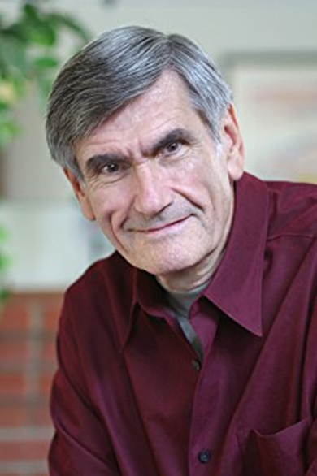
INTRODUCTION
Marshall Rosemberg
(1934-2015)

Slide 4
Marshall Rosemberg
Born in a jewish family, he experienced the love and caring from his family
At the age of 9, he moved to Detroit, USA (race war and violence)
School year and violence
He lived two diferente realities: at home and in the society

Slide 5
The search begins…
He wanted to understand :
1 - What happens to disconnect us from our compassionate nature, leading us to behave violently and exploitatively
2 - What allows some people to stay connected to their compassionate nature under even the most trying circunstances

Slide 6
The birth of Non Violent Communication
He was struck by the crucial role of language and our use of words
He identified a specific approach to communication (speaking and listening), that gives from the heart, connecting us with ourselves and each other in a way that our natural compassion can flourish
He call it: Non violent Communication (NVC)

Slide 7
Purpose of NVC
To inspire compassionate, heartfelt connection so that the needs of all may be valued
To connect with ourselves and others
To be inspired and to inspire others to give from the heart

Slide 8
What NVC is not
It is not being nice, is about to be REAL; It is not about stifling intensity but transforming it
Is not about changing other people or getting them to do what we want, it is about creating connection and understanding
Is not a technique or a formula – it is a process that helps to guide our consciousness to a new awareness

Slide 9
On learning NVC….
It is a diferent kind of learning, it is not only intelectual by talking about NVC
It takes place more powerfully when we seek to connect with the other one and ourselves
It is not getting right, it is to move toward the connection we desire

Slide 10
Creating the internal space
The learning of NVC happens more fully when we create a place in ourselves that supports that learning:
a place of spaciusness. We are discovering what is already there, not putting more stuff in
a place of awareness of self in this moment, noticing my thoughts, my body sensations, my feelings, my intentions, my needs, my choices

Slide 11
Creating the internal space
a place of openness. Finding where I am tense or distracted
a place of choice. Where there is no “have to”, no “should”, no “supposed to”. There are only choices
a place of self-compassion. Where there are no judgments, no right or wrong, no punishments or rewards. Remembering that I am trying to get my needs met in the best way I know how
a place where I remember what I am responsible for what I am not responsible for

Slide 12
Creating the community space that nurtures learning and connection
a space of remembering our common intention for coming together, to connect with one another
a space of inclusiveness. Where each person is invited and given the space to be heard where your needs matter so much as my own
a space of authenticity where I vulnerably express my own feelings and needs as best as I can

Slide 13
Creating the community space that nurtures learning and connection
a space of empathy where I strive to hear feelings and needs no matter what is being said, where I give each person plenty of space until that person has fully heard
a space of conscious choice where I strive to hold our common intention, the needs of each person, my own needs, as I choose how to best meet these needs, where I honor the choices of those around me
a space of compassion, where are no judgments, no right or wrong, no demands, no punishments or reward,only people trying to get their needs met in the best way they know how

Slide 14
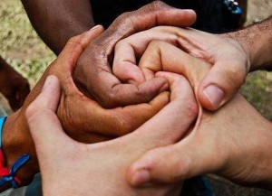

Slide 16
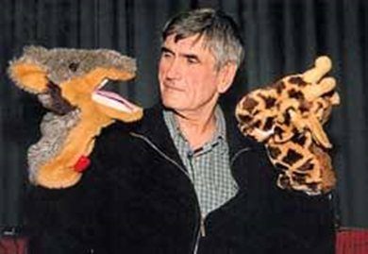
COMMUNICATION THAT BLOCKS COMPASSION (Life alienating communication)
“Giraffe” Vs “Jackal”

Slide 17
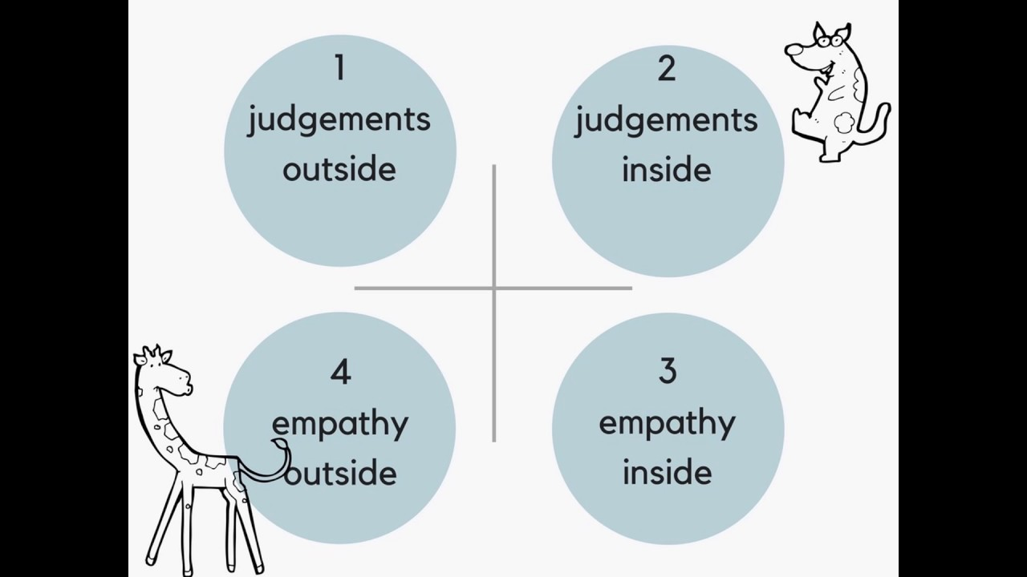

Slide 18
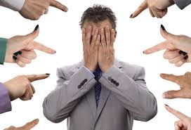
1 – Moralistic Judgments
“Do not judge, and you will not be judged. For as you judge others, so you will yourselves be judged….Mt 7:11”
“ Judgements and violence are tragic expressions of unmet needs” M.R.
Blame, insults, put-downs, labels, criticisms, comparissons and diagnoses are all forms of judgments

Slide 19
1 – Moralistic Judgments
EX: “ The problema with you is that you are too selfish….”
“ She is lazy”
“ They are prejudiced”
“ It is inapropriate”
In a world of judgements, our concern centres on “who is what”
We think and communicate in terms of what is wrong with others for behaving in such ways
We think on what is wrong with us for not understanding or responding in the way we like
As a result we are determining levels of wrongness rather than what we or others need and are not getting

Slide 20
Value judgments and Moralistic judgments
Value judgments - we do it as to the qualities we value in life
Moralistic judgment - we do it when people and behaviors fail to support our value judgments
EX: “ Violence is bad.People who kill others are evil”
In NVC: “I am fearful of the use of violence to resolve
conficts; I value the resolution of human conflicts through
other means”

Slide 21
Making Comparisons
Comparisons are a form of judgment and block compassion both in oneself and in others.
D. Greenburg wrote a book “How to make yourself miserable” through humor he brings exercises to compare:
Ourselves with man and woman with ideal physical beauty by contemporary media standarts
Achievement : A. Mozart as a teenager spoke many languages and composed major pieces

Slide 22
Denial of Responsibility
Communication is life-alienating when it clouds our awareness that each one of us is responsible for our thoughts, feelings and actions.
Ex: “I had to”; “Superiors’ orders”; “Company policy”; “It is the law”

Slide 23
Denial of Responsibility (cont.)
We deny responsibility for our actions when atribute their cause to facts outside ourselves:
The actions of others –“ I hit my child because he ran into the street”
The dictates of authority – “I lied to the client because the boss told me to”
Group pressure – “ I started to smoke because all my friends did”
Institutional policies, rules and regulations – I have to suspend you for this infraction because is the school policy”
Gender roles, social roles, age roles – “ I hate going to work, but I do because I am a husband and a father”
Vague, impersonal forces – “ I cleaned my room because I had to”
Uncontrollable impulses – “I was overcamed by my urge to eat the candy bar”

Slide 24
Denial of Responsibility (cont.)
Problem:
We are dangerous when we are not conscious of our responsibility for how we behave, think and feel.
Solution:
We can replace language that acknowledges choice: “ I choose to….”

Slide 25
Demands
Communicating our desires as demands is yet another form of language that blocks communication.
A demand explicity or implicity threatens listeners with blame or punishment if they fail to comply.

Slide 27
OBSERVATION (Observing without evaluating)
Observations are an important element in NVC, where we wish to clearly and honestly express how we are to another person.
It is descriptive. Is what we can see, hear or touch.
“When I see….”
“When I hear….”
“When I recall seeing / hearing…..”

Slide 28
OBSERVATION (Observing without evaluating)
The evaluation envolves making inferences about the things we observe and are specific to time and context.
“Henry is aggressive”
Vs
“ Henry hit his sister when when she played with his smartphone”

Slide 29
OBSERVATION (Observing without evaluating)
“you are too generous” vs “ When I see you give your lunch money to others I think you are too generous”
“Luke procrastinates” vs “ Luke studied for the test the night before”
“She won’t get her work done” vs “ I don’t think she will get her work in”

Slide 30
OBSERVATION (Observing without evaluating)
“ If you don’t eat balanced meals, your health will be impaired” vs “ If you don’t eat balanced meals, I fear that your health will be impaired”
“Richard is a poor football player” vs “ Richard has not scored a goal in 20 games”

Slide 31
OBSERVATION (Observing without evaluating)
The words always, never, ever, whenever, express observations when used in the following ways:
Whenever I have observed Jack on the phone, he has spoken for at least 30 min
I can not recall you ever writing to me

Slide 32
OBSERVATION (Observing without evaluating)
When such words are used as exagerations, observations and exagerations are being mixed and provoque defensiveness rather than compassion
You are always busy
She is never there when she’s needed

Slide 33
OBSERVATION (Observing without evaluating)
Words like frequently and seldom can also contribute to confusing observation with evaluation
“You seldom do what I want” is na evaluation
“The last 3 times I initiated an activity, you said you didn’t want to do it” is one observation

Slide 34
OBSERVATION (Observing without evaluating)
“He frequently comes over” is an evaluation
“he comes over at least three times a week

Slide 35
OBSERVATION (Observing without evaluating)
“Observing without evaluating is the highest form of human intelligence” J.Krishnamurti.
When we mix together the two, the other one becames defending or criticizing us, and it is not a compassionate communication.

Slide 36
OBSERVATION (Observing without evaluating)
I can handle your telling me
What I did or didn’t do.
And I can handle your interpretations,
But please, don’t mix the two.
If you want to confuse any issue,
I can tell you how to do it:
Mix together what I do
with how you react to it.
Marshall Rosemberg

Slide 37
OBSERVATION (Observing without evaluating)
Observation Check
Is my observation free of evaluation?
Does my observation contain words such as “always”, “never”, “Whenever”, etc?

Slide 39
FEELINGS ( Identify and express feelings)
As long as we live, we experience feelings, regardless we are aware of them or not.
Our feelings are dynamic, can change in seconds and reveal wheather:
Our present need is being met – we experience pleasure feelings… joy, relieved, calm
Present need not being met – we experience painful feelings just like disappointment, frustration, sadness

Slide 40
Feelings vs Thoughts
In general, feelings are not clearly expressed when the word feel is followed by:
1. Words such as that, like, as if:
“ I feel that you should know better”
“ I feel like a failure”
“ I feel as if I am living with a wall”
2. The pronouns I, you, he, she, they, it:
“ I feel I am constantly on call”
“ I feel it is useless”

Slide 41
Feelings vs Thoughts
3. Names or nouns reffering to people:
“ I feel Peter has been pretty responsible”
“ I feel my boss is being manipulative”

Slide 42
Feelings vs Perception of ourselves
Description of what we think we are
“ I feel inadequate as a guitar player”, in this
statement I am assessing my ability as a guitar
player, rather than expressing my feelings.
Expression of factual feelings:
“ I feel disappointed in myself as a guitar player”
“ I feel impatient with myself as a guitar player”
“ I feel frustated with myself as a guitar player”

Slide 43
Feelings vs Perception of others are doing to us
“I feel unimportant to the people with whom I work”
Unimportant describes how I think others are evaluating me, rather than a feeling, which could be “ I feel sad” or “ I feel discouraged”
“I feel misunderstood”
Misunderstood indicates my assessment of the other person’s level of understanding rather than an actual feeling, may be feeling anxious or anoyed or some other emotion.

Slide 44
Feelings vs Perception of others are doing to us
“I feel ignored”
This is more one interpretation of the actions of others than a clear statement of how we are feeling.
We are ignored and it is a relief because we wanted to be left by ourselves
We feel hurt when we thought we were being ignored, because we had wanted to be involved.

Slide 45
Interpretations (not feelings) we confuse with feelings
Negleted
Manipulated
Taken for granted
Used
Disregarded

Slide 46
General Vs. Specific emoticons
It helps to use words that refer to specific emotions rather than words that are vague or general (like good or bad)
I feel good about that - Can mean happy, excited
I feel good about what you did to me – vague feeling, relieved, gratified)

Slide 47
EXPRESSING FEELINGS
1 – I feel you do not like me
2 – I am sad that you are leaving
3 – I feel scared when you say that
4 – When you don’t greet me, I feel negleted
5 – I am happy that you come
6 – You are disgusting
7 – I feel like hitting you
8 – I feel misunderstood
9 – I feel good about what you did to me
10 – I am worthless

Slide 48
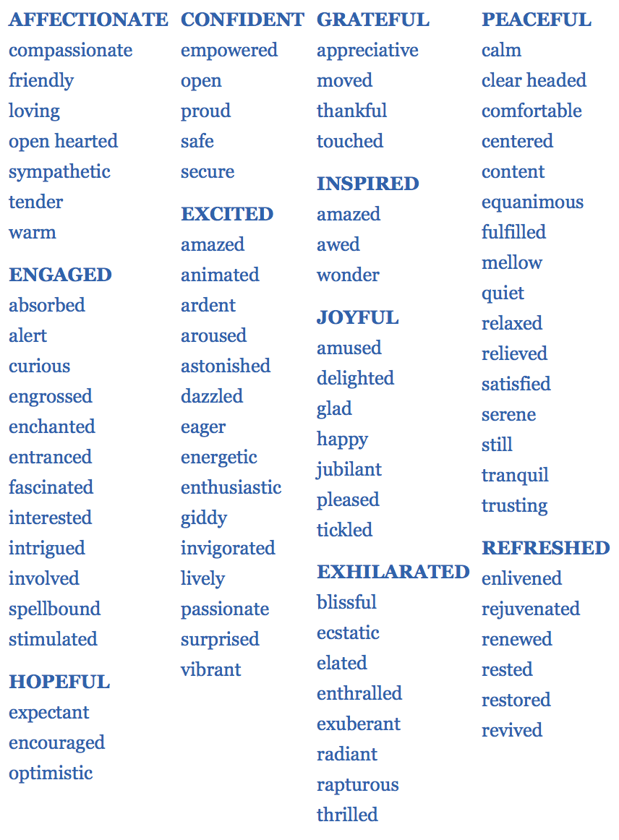

Slide 49
Building own inventory of feeling
Imagine all kind of situations where life is
going exactly the way you’d want.
Write on a piece of paper all your feelings you might feel in these situations

Slide 50
Building own inventory of feeling
Now imagine the kind of situations where your needs were not being met
Write down the feelings you might feel in those situations

Slide 51
Building own inventory of feeling
Challenge yourself to continually add to these lists as you build your own
Symphony orchestra of feelings!

Slide 53
NEEDS (Taking responsibility for our feeling )
This component of NVC entails the aknowledgment of the root of our feelings.
What others say or do to us:
Is that the cause of our feelings?
Is that the stymulus?
Our feelings result from how we choose to receive what others say and do, as well from our particular need and expectation at the moment
So, we accept responsibility for what we do to generate our own feelings

Slide 54
NEEDS (Taking responsibility for our feelings )
“The more faithfully you listen
To the voice within you,
The better you will hear
What is sounding outside”
D. Hammarskjold

Slide 55
Four options on how to receive a negative message
“you are the most self-centered person I’ve ever met”
1– Blame ourselves
We choose to take it personally and accept the other’s judgment and blame ourselves (great cost of self esteem, for it inclines us to feelings of guilt, shame and depression)
“Oh, I should have been more sensitive”

Slide 56
Four options on how to receive a negative message
2 – Blame the speaker
We choose to blame the speaker (and feel angry)
“You have not the right to say that! I am always considering your needs, you are the one who is really self-centered”

Slide 57
Four options on how to receive a negative message
3 – Sense our own feelings and needs
Shine the light of conscienciousness on our own feelings and needs
“When I hear you saying that I am the most self-centered person you’ve met, I feel hurt, because I need some recognition on my efforts to be considerate of your preferences”

Slide 58
Four options on how to receive a negative message
4 – Sense other’s feelings and needs
Shine the light of conscience on the other person’s feelings and needs
“Are you feeling hurt because you need more consideration for your preferences?”

Slide 59
Being motiveted out of guilt
The basic mechanism of motivating others by guilt is to atribute the responsibility for one’s own feelings to others”
“It hurts Mommy and Daddy when you get poor grades at school”
It implies:
Child’s actions are the cause of the parents’ happyness or unhappines.
Being responsible for the feelings of others can be mistaken for positive caring
This responsibility changes the child’s behavior in accordance to parental whishes
The child does not act from the heart, but to avoid guilt

Slide 60
Ways of denial of responsibility
1 – Denial of responsibility by using impersonal pronoums, like it and that
“ It really injuriates me when spelling misakes appear in our articles”
2 – Denial of responsibility by mention only the actions of others
“Mommy feels disappointed when you don’t finish your food”
3 – Denial of responsibility by “ I feel …..because you”
“ I feel disappointed because you said you will do it and you didn’t”

Slide 61
The need at the root of our feelings
Most of us have never been taugh to think in terms of needs
We are used to think about what’s wrong with other people when our needs are not met
Judgments, criticism, diagnoses and interpretatioms of others are all alienated expressions of our own vallues and needs

Slide 62
How can be the different approach in NVC?
We can deepen our awareness of ur own responsibility by
“I feel……because I…..”

Slide 63
Examples of clearly connecting a feeling with a need
When I see the sink full of dirty dishes I become annoyed, because I need order and cleanliness in my life”
When you arrived 30 min after the appointed time I was frustrated, because I want to follow my schedule planned in order to have a sense of accomplishment for the day”

Slide 64
Examples of clearly connecting a feeling with a need
When you said you enjoyed the story I wrote I felt elated, because I need to feel confident about my skills as a writer
When the children fight on the playground I feel frightned, because I need a sense of safety for myself and others”

Slide 65
Selfish vs Selfless vs Self-full
Selfish: I only value my own needs
Selfless: I only value other’s needs
Self-full: I value my own needs and other’s needs equally

Slide 66
The path to emotional liberation
Stage 1, Emotional Slavery: we believe we are responsible for the feelings of others
Stage 2, Obnoxious stage: We no longer want to be responsible for the feelings of others….and often express it with anger
Stage 3, Emotional liberation: We accept responsibility for our own intentions and actions, but not for the feeling of others. We respond to the needs of others only out of compassion and a desire to contribute, never out of guilt, fear or shame.

Slide 67
Our gratest need
“Pray without ceasing” II Tes 5:17

Slide 68
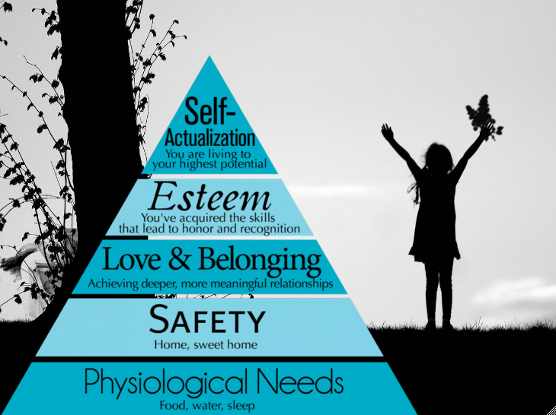

Slide 69
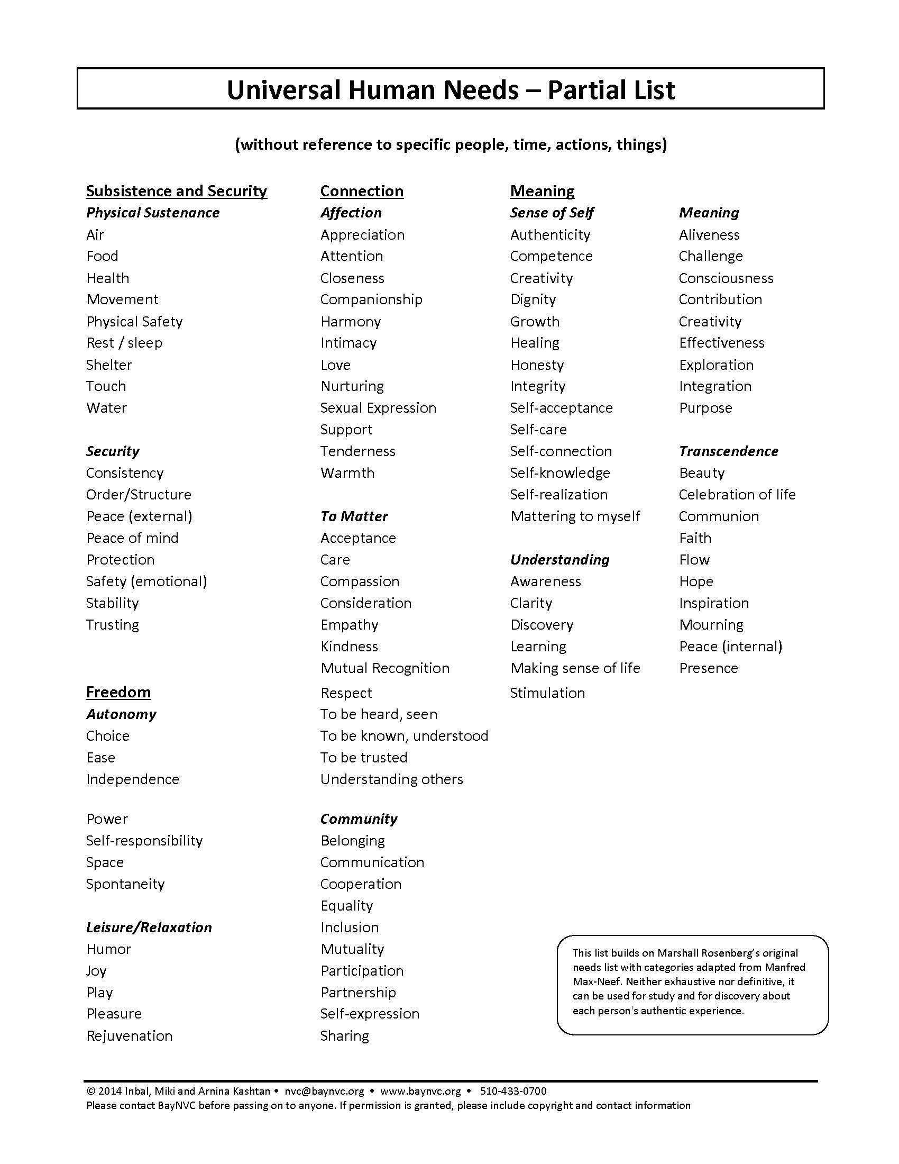

Slide 70
Some Basic needs we all have
Needs document
Exercise 1 : Acknowledging needs
Exercise 2: What is the need here?

Slide 72
Request
Only after a connection has happened between people (i.e. mutual understanding of each person’s feelings and needs) do we seek to find solutions ( “Connections first, then solutions”)
We are more likely to get our needs met when:
1 – we are conscious of our needs
2 – we explicity make a request that may fulfil our needs (“ask for what you need”)

Slide 73
Request
In making a request, we honor a “NO” as much as a “YES”
Are we willing to try to understand what a person is saying “YES” to, while is saying “NO” to us?
Do we value the other’s people needs in that moment as much as our own?

Slide 74
Request
Peter: “ I’d like to understand your needs so we can work out this problema. Would you be willing to talk about it for 5 mim?”
Mary: “ I don’t want to talk now”
Peter: “Are you exhausted and want some rest?”
Mary: “No, I just want to sit here and be left alone”
Peter: “So, you want to just be with youeself right now?”
Mary: “Yes, I do”
Peter: “ I want to trust that we’ll work this out soon…will you be willing to talk this afternoon after lunch?
Mary: “Yes, but not now”
Peter. “OK, we will meet after lunch”

Slide 75
Request
Request Cues
Would be willing to……?”

Slide 76
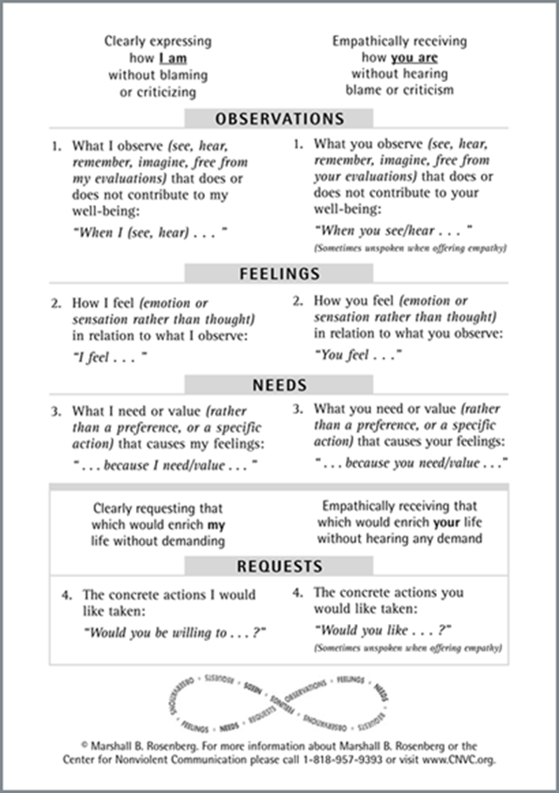

Slide 77
Ask for a reflection
When we are uncertain that the message is received as intended, we clearly request a response that tells us how the message was heard.
“ Is that clear?”
“Could you tell me what you just heard me say?”

Slide 78
Ask for a reflection (Cont)
When the message was not received, instead of telling
“You didn’t hear me” or “That’s not what I said” in NVC is:
“I am grateful to you for telling me what you heard. I can see that I didn’t make myself as clear as I’d have liked, so let me try again”

Slide 79
Ask for a reflection (Cont)
When the listener doesn’t want to reflect back
“ I heard what you said; I am not stupid!” or “What do you think I am – deaf?”
In NVC, we empathize with the listener
“Are you saying you are feeling annoyed because you want respect for your ability to understanding things?”

Slide 80
Requesting Honesty
After we express ourselves vulnerably, we often want to know:
What the listener is feeling
“ I would like you to tell me how you feel about what I just said, and your reasons for feeling as you do”

Slide 81
Requesting Honesty (Cont)
What the listener is thinking
“ I’d like you to tell me if you predict that my proposal would be successful and if not, what you believe would prevent its success”
“I would like you to tell me what you think about what I’ve said”

Slide 82
Requesting Honesty (Cont)
Whether the listener would be willing to take a particular action
“ I’d like you to tell me if you would be willing to postpone our meeting for one week”

Slide 83
Request vs Demand
The request is received as a demand, when the person believe will be blamed or punished if not comply
It is a demand if the speaker criticizes or judges
When a person hear a demand, only sees two options: Submission or rebellion

Slide 84
Request vs Demand
It is a request if the speaker then shows empathy toward the other person’s needs”

Slide 85
Our goal when making request
Our goal in NVC is not to change people and their behavior in order to get our way
The goal is to establish relationships based on honesty and empathy that will eventual fulfill everyone’s needs

Slide 87
Empathy
Jesus and the woman at the well – Jo 4:30

Slide 88
Empathy
Empathy is a respectful understanding of what others are experiencing.
It demands presence, responsibility; it demands me!
How to do it?
It requires us to focus full attention on the other person’s message
We give to others the time and space they need to express themselves and to feel understood
Intellectual understanding blocks empathy
No matter what the person says, we only hear what they are: abserving,feeling, needing and requesting

Slide 89
Empathy
What prevents us from being sufficiently present to connect empathically with others? Intellectually understanding blocs empathy. We need the heart!
Advising: “I think you should…..”
One-upping: “That’s nothing; wait I’ll tell you what happened with me”
Educating: “This could turn into a very positive experience for you if you just….”
Consoling: “It wasn’t your fault; you did the best you could”

Slide 90
Empathy
Shutting down: “Cheer up. Don’t feel so bad”
Sympathizing: “Oh, you poor fellow…”
Interrogating: “When did this begin?”
Explaining: “ I would have called but….”
Correcting: “ That’s not how it happened”

Slide 91
Empathy
Exercise
Someone says to you:
“I couldn’t sleep until 3 a.m. last night, thinking about my prayer meeting presentation today. So, now my head is killing me! Why do I get such headhaches when something importante needs to be done?”
Give a reply that reveals educating
Give a reply that offers advice
Give a reply that demonstrates sympathy
Give a reply verbalizing empathy

Slide 92
Paraphrising
We may wish to reflect back what we have understood. It contributes to greater compassion and undersanding
By choose to reflect a message back to the person, offers them time to reflect on what they have said and on the opportunity to go deeper into themselves
In NVC, it is done by:
1. - Making questions:
What the other is abserving: “ Are you reacting on how many evenings I was gone last week?”
How the other is feeling and the need behind it: “Are you feeling hurt because you would like to have more appreciation of your efforts than you receive?”
What others are requesting: ”Are you wanting me to tell you my reasons for what I did?”

Slide 93
Paraphrising
2. - A reflection of feelings and needs as a confirmation that the person had been heard
“ You never listen to me”
“ It sounds like you are terribly frustrated because you would like to feel more connection when you speak”

Slide 94
Sustaining empathy
Allow the person to fully express themselves before turning our attention to solutions or requests for relief.
What is the evidence that we have fully empathyzed with the person?
The person experiences relief and stop talking.

Slide 95
When pain blocks our ability to empathize
We openly acknowledge that our distress is preventing us from respond empathically
“Emergency first aid empathy” – we listen to what is going on inside of us with the same quality of presence and attention we offer to others
We give ourselves time out and the opportunity to acquire the empathy we need to return in a diferente frame of mind

Slide 97
Empathy
Exercises (receiving empathically vs non empathically)
In the document given
Individual Practice
In the document given

Slide 99
Self-empathy
Connecting compassionately with ourselves
The most importante use of NVC may be in developing self-compassion.
When we are internally violent toward ourselves, it is difficult to be genuinely compassionate toward others.

Slide 100
NVC Mourning
Mourning in NVC is the process of fully connecting with unmet needs and the feelings that are generated when we have been less than perfect
It is an experience of regret without blaming or hating ourselves.

Slide 101
NVC Mourning
Use the flow of the chart given to mourn a choice you made in the past that you now regret
Observation: What I did in the past that I now regret
Self-judgments: What I think of myself for having done or said
Current feelings and needs: translate self-judgments into feelings and needs
Empathy for yourself: determine what need I was trying to fulfill when I chose to take the action or say the words I now regret
Current request of myself: Aware of my current feelings and unfulfilled needs, I would like to address my needs in this manner

Slide 102
Translating “ Have to” to “Choose to”
There are things we don’t like doing, but we have to do them anyway.
In NVC,
“ I have to……………………………”
Is “translated” into:
“ I chose to…………………. because I want to………..”

Slide 103
Anger (Express anger fully in NVC)
Divorce the other person from any responsibiity for our anger
We are never angry because of what others say or do
Violence comes from the belief that other person cause our anger
The cause of our anger lies in our thinking – it is our evaluation of what has been done that is the cause
When we become aware of our needs, anger gives way to life-serving feelings

Slide 104
Anger (Express anger fully in NVC)
4 Steps to expressing anger
1 – Stop. Breathe
2 – Identify our judgmental thoughts (should-thinking)
3 – Connect with our needs
4 – Express our feelings and unmet needs
Between the step 3 and 4, we may choose to empathize with the other person so that he or she will be able to hear us when we express ourselves in step 4

Slide 105
Taking our time
For most of us, the complete process of “expressing anger fully” often requires time.
We need time both in learning and applying the process of NVC
Ex. Sam at his job
Sam at home “ Daddy get the card”

Slide 107
Giving and receiving gratitude
Compliments
Conventional compliments often take the form of judgments, however positive and are sometimes intended to manipulate the behavior of others.

Slide 108
Appreciation
Appreciation: what is alive in ourselves (feelings and needs met) stimulated by the other person’s actions
When we use NVC to express appreciation, it is purely to celebrate, not to get something in return
Our sole intention is to celebrate the way our lives have been enriched by others

Slide 109
Receiving Appreciation
NVC encourages us to receive appreciation with the same quality of empathy we express when listening to other messages.
We hear what we have done that has contributed to other’s well being
We hear their feelings and the needs that were fulfilled
We take into our hearts the joyous reality that we can each enhance the qualty of other’s people lives

Slide 110
Receiving Appreciation
It is not:
False humility: denies the importance of the appreciation “It was nothing”
Feeling of superiority: Thinking “I am better than others because I received the appreciation or compliment”

Slide 111
Saying “Thank you” in NVC
This is what you did
This is what I feel
This is the need of mine that was met

